Slide 1
Designing Performant Systems for Human-Powered Data Analysis
Daniel Haas
Advisor: Michael J. Franklin
Dissertation Talk
University of California, Berkeley
Department of Electrical Engineering and Computer Science
May 15th, 2017

Slide 2
Today’s systems need labeled data, fast.

Slide 3
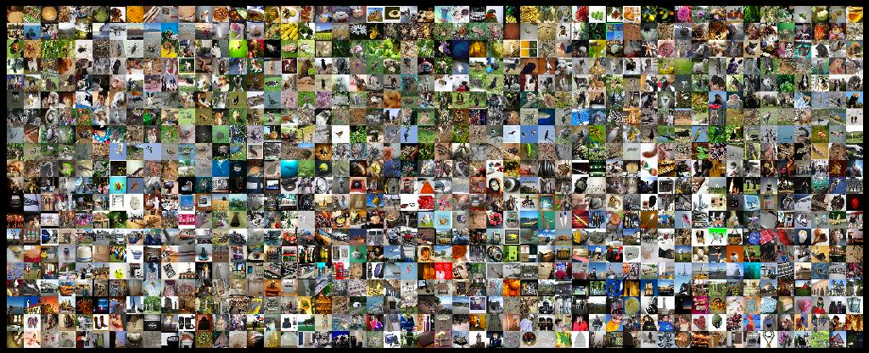

Supervised learning

Slide 4

Data cleaning
=
?
iPhone 4s 16GB (White)
White iphone 4S 16
Entity Resolution

Slide 5
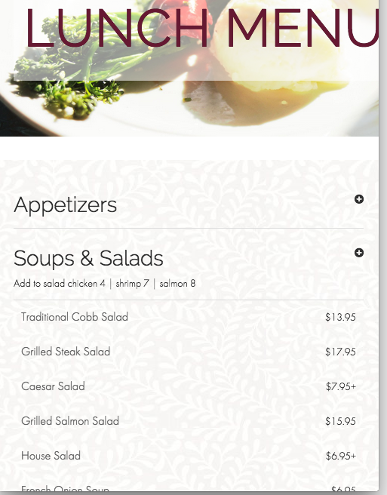
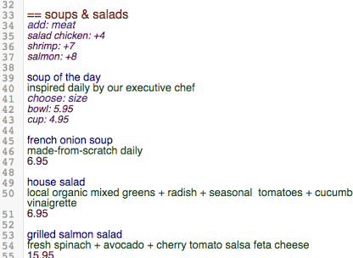
Structured data extraction

Slide 6


Real-time applications
Answering visual questions for blind users
[Bigham et al. 2010]
Crowd-assisted photography
[Bernstein et al. 2011]

Slide 7
Humans process a lot of data
“participants reported hundreds of employees deploying hundreds of thousands of tasks per week, with overall spending in the millions of dollars per year.
”
A. Marcus and A. Parameswaran. Crowdsourced data management: industry and academic perspectives. Foundations and Trends in Databases, 2015.

Slide 8




Enter the microtask
In the literature:
CrowdDB, Deco, Qurk,
Corleone, CrowdER,
DataTamer, Usher, …
YES
NO

Slide 9
Problem: crowds are not fast

Slide 10
Problem: crowds are not fast
Completing individual microtasks should be quick.

Slide 11
Problem: crowds are not fast
Completing individual microtasks should be quick.
But papers report latencies of minutes to hours per task, or use cost as a proxy for latency!

Slide 12
Problem: crowds are not fast
Completing individual microtasks should be quick.
But papers report latencies of minutes to hours per task, or use cost as a proxy for latency!
This is too slow and too variable for interactivity.

Slide 13


Our challenge
Data Analysts
Automated Applications
Requests
Requests
???
Tasks
Crowd Platform

Slide 14
Our challenge
Data Analysts
Automated Applications
Requests
Requests
Interactive timescales
Reliable response times
For many applications
Tasks
Crowd Platform

Slide 15
Solution: performant crowd systems
CLAMShell (VLDB 2016)
How fast can a single application go?
8x latency reduction, 150x variance reduction
Available open source!
Adaptive worker identification (NIPS 2016)
How to find fast workers in an unknown crowd?
Novel algorithms, with proofs!
Cioppino (In submission, HCOMP 2017)
How to manage many applications at once?
19x cheaper, 20% higher throughput
Takes worker preferences into account

Slide 16
Key insight:
a crowd is a distributed system!

Slide 17
Key insight:
a crowd is a distributed system!
^
not quite

Slide 18
Solution: performant crowd systems
CLAMShell (VLDB 2016)
How fast can a single application go?
8x latency reduction, 150x variance reduction
Available open source!
Adaptive worker identification (NIPS 2016)
How to find fast workers in an unknown crowd?
Novel algorithms, with proofs!
Cioppino (In submission, HCOMP 2017)
How to manage many applications at once?
19x cheaper, 20% higher throughput
Takes worker preferences into account

Slide 19
Where does the time go?
Labeling System
Learning
System
Dataset
Pool of Crowd Workers

Slide 20
Where does the time go?
Labeling System
Batch of
records
Learning
System
Dataset
Pool of Crowd Workers

Slide 21
Where does the time go?
Labeling System
Batch of
records
Labeling
tasks
Learning
System
Dataset
Pool of Crowd Workers

Slide 22
Where does the time go?
Labeling System
Batch of
records
Labeling
tasks
Learning
System
Dataset
Recruit Time
Pool of Crowd Workers

Slide 23
Where does the time go?
Labeling System
Batch of
records
Labeling
tasks
Learning
System
Dataset
Work Time
Recruit Time
Pool of Crowd Workers

Slide 24
Where does the time go?
Labeling System
Batch of
records
Labeling
tasks
Labels
Learning
System
Dataset
Work Time
Recruit Time
Pool of Crowd Workers

Slide 25
Where does the time go?
Batch Time
Labeling System
Batch of
records
Labeling
tasks
Labeled
records
Labels
Learning
System
Dataset
Work Time
Recruit Time
Pool of Crowd Workers

Slide 26
Where does the time go?
Batch Time
Labeling System
Batch of
records
Labeling
tasks
Labeled
records
Labels
Learning
System
Learning
Time
Dataset
Labeled Dataset
Work Time
Recruit Time
Pool of Crowd Workers

Slide 27

The CLAMShell
System
Task batch
Labeling
tasks
Task Selector
Batcher
Labels &
predictions
Model Trainer
User

Slide 28
The CLAMShell
System
Pool Manager
Scheduler
LifeGuard
Mitigator
Maintainer
Task batch
Labeling
tasks
Task Selector
Batcher
Labels &
predictions
Model Trainer
User

Slide 29
Retainer Pool Slots
S₁
S₂
S₃
✗
S₄
Crowd
Platform
T₀’
T₀
T₁
The CLAMShell
System
Mitigation
task
New task
Churn
Labels
Pool Manager
Scheduler
LifeGuard
Mitigator
Maintainer
Task batch
Labeling
tasks
Task Selector
Batcher
Labels &
predictions
Model Trainer
User

Slide 30
Implementation
AMPCrowd (https://amplab.github.io/ampcrowd)
Python/Django/PostgreSQL
Declarative API
Crowd platform-independent
Automated quality control
+ All the low-latency techniques in this talk

Slide 31
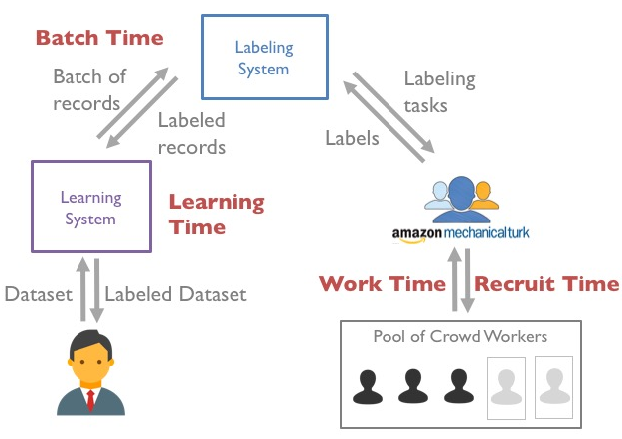
Attacking latency
Work Time
Recruitment Time
Batch Time
Learning Time

Slide 32
Attacking latency
Work Time
Recruitment Time
Batch Time
Reduce tail latency with straggler mitigation
Reduce average latency with pool maintenance
Learning Time

Slide 33
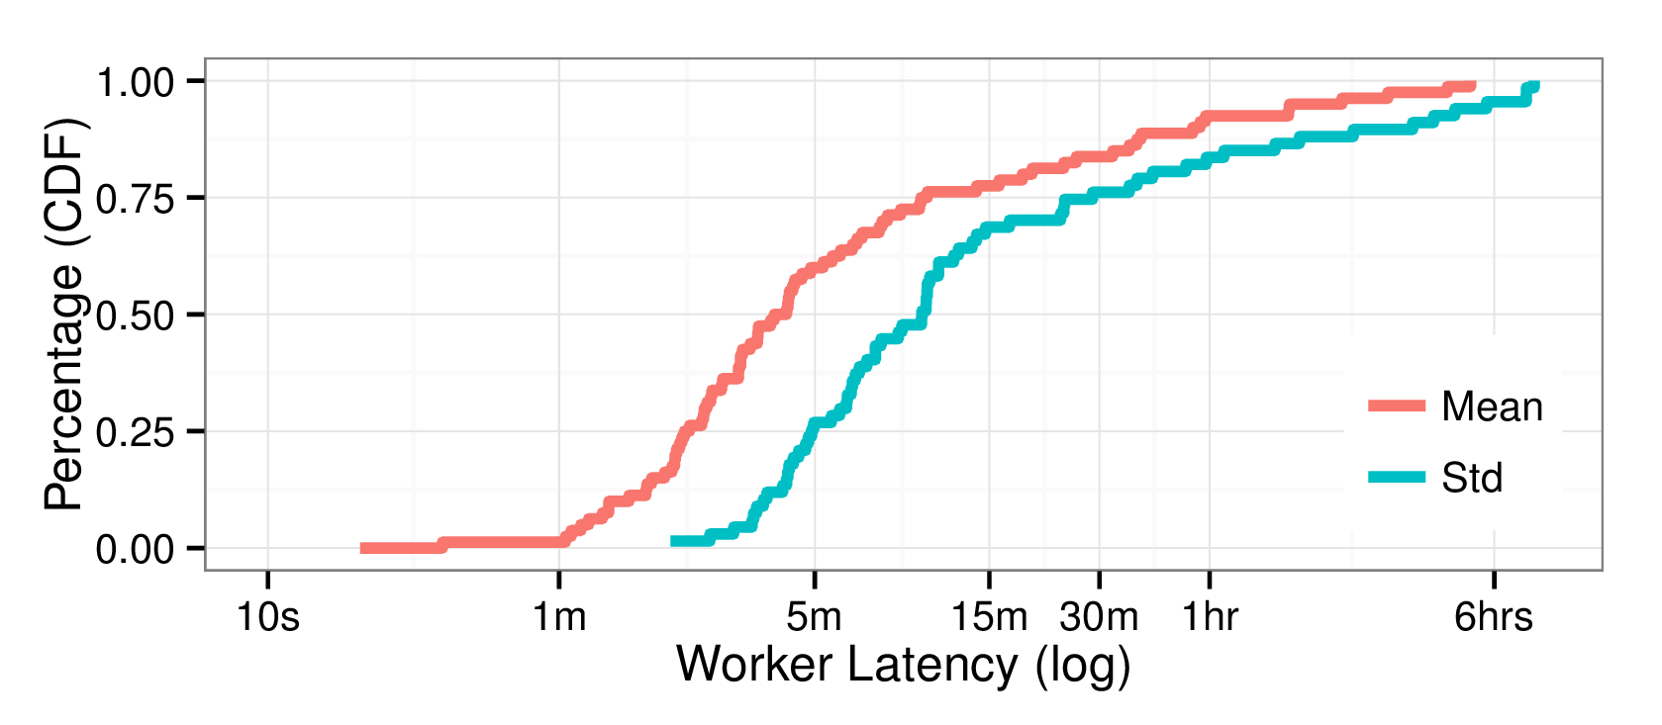
Reducing batch time

Slide 34
Reducing batch time: tail latency
Long tail

Slide 35


Reducing batch time: tail latency
Y
N
Y
N
Y
N

Slide 36
Reducing batch time: tail latency
Straggler
mitigation
Y
N
[Dean et al. 2008]
[Zaharia et al. 2008]
[Ananthanarayanan et al. 2010]
Y
N
Y
N
Y
N

Slide 37
Reducing batch time: tail latency
Subtleties:
Interface. Make the experience less jarring for workers.
Cost. When to pay? What’s the overhead?

Slide 38
Reducing batch time: avg. latency
Slow average speed

Slide 39
Reducing batch time: avg. latency
Track worker speeds and release slow workers!
Current Crowd Worker Pool
Worker₁
Worker₂
Worker₃
Avg. Speed:
4 s / task
Avg. Speed:
6 s / task
Avg. Speed:
10 m / task
We call this “Pool Maintenance”

Slide 40
Reducing batch time: avg. latency
Track worker speeds and release slow workers!
Current Crowd Worker Pool
✗
Worker₁
Worker₂
Worker₃
Avg. Speed:
4 s / task
Avg. Speed:
6 s / task
Avg. Speed:
10 m / task
✗
= marked for release

Slide 41
Reducing batch time: avg. latency
Track worker speeds and release slow workers!
Current Crowd Worker Pool
Worker₁
Worker₂
Empty
Avg. Speed:
4 s / task
Avg. Speed:
6 s / task
Recruit asynchronously to reduce empty time

Slide 42
Reducing batch time: avg. latency
Track worker speeds and release slow workers!
Current Crowd Worker Pool
Worker₁
Worker₂
Worker₄
Avg. Speed:
4 s / task
Avg. Speed:
6 s / task
Avg. Speed:
???
Compute speeds with confidence intervals to avoid mistakes

Slide 43
Evaluating CLAMShell
Over 1,000 workers on MTurk, ~250,000 tasks, $15-20k
Datasets: CIFAR, MNIST
Paid workers $.02 / task, $.05 / minute

Slide 44
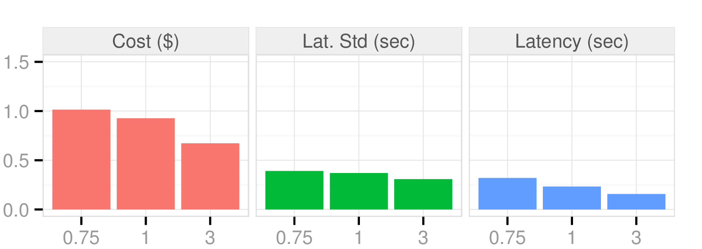
Effects of straggler mitigation
SM / No SM Ratio
Avg. # workers / task
Up to 5x speed-up, 10x variance reduction
over base retainer pool implementation
with under 2x cost increase

Slide 45
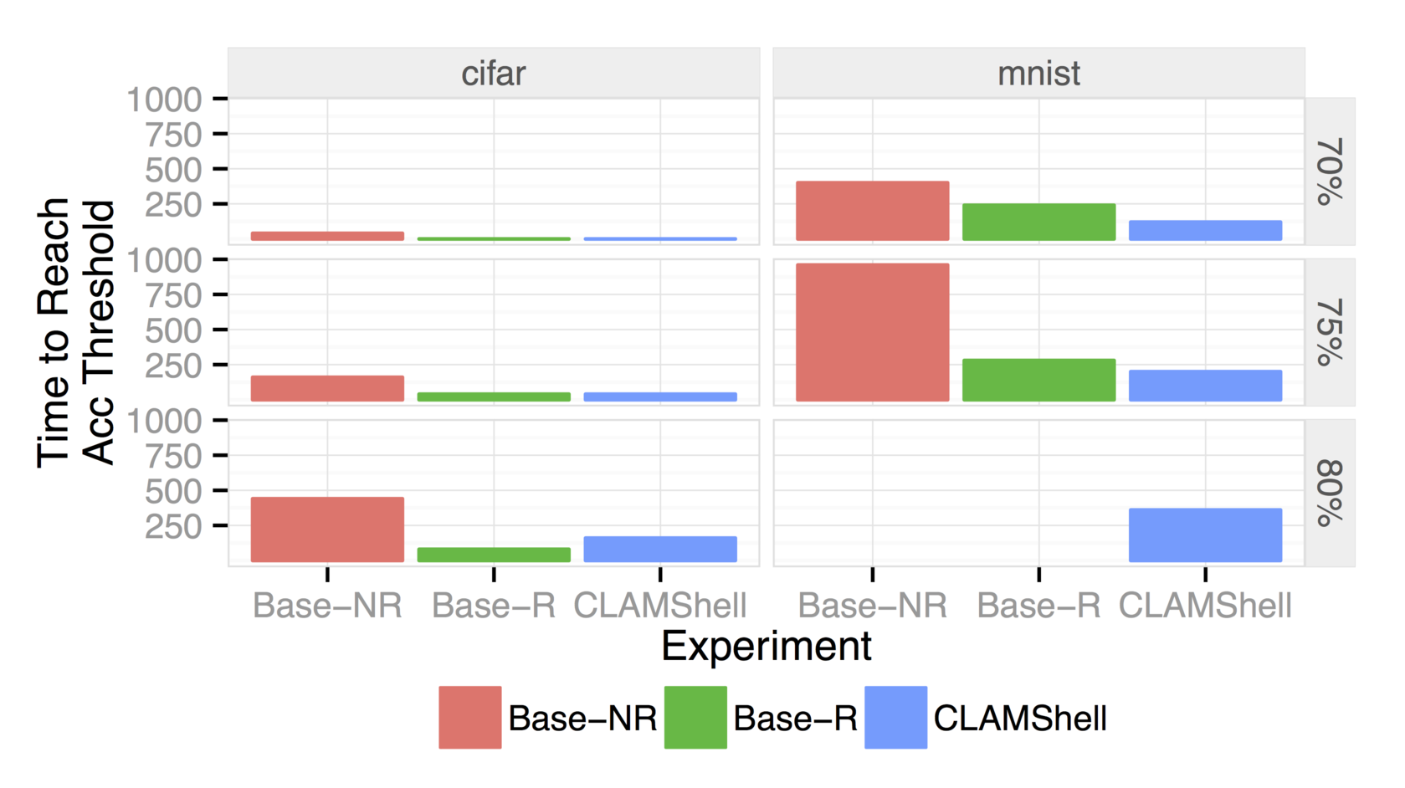
End-to-end performance
Time to reach
threshold (sec)
Accuracy Threshold
✗
✗
Up to 8x speed-up, 151x variance reduction over Base-NR.
Notes:
Build in—show 70%, 75%, 80%

Slide 46
CLAMShell: Summary
Batch Time
Labeling System
Batch of
records
Labeling
tasks
Labeled
records
Labels
Learning
System
Learning
Time
Dataset
Labeled Dataset
Work Time
Recruit Time
Pool of Crowd Workers

Slide 47
Solution: performant crowd systems
CLAMShell (VLDB 2016)
How fast can a single application go?
8x latency reduction, 150x variance reduction
Available open source!
Adaptive worker identification (NIPS 2016)
How to find fast workers in an unknown crowd?
Novel algorithms, with proofs!
Cioppino (In submission, HCOMP 2017)
How to manage many applications at once?
19x cheaper, 20% higher throughput
Takes worker preferences into account

Slide 48
Improving pool maintenance
User-supplied threshold requires knowledge of crowd worker statistics
No guarantees on rate of finding a good pool

Slide 49
Can we do better?
Big simplifying assumption: workers are either ‘fast’ or ‘slow’
Now, the search for fast workers is modeled by the “most biased coin” problem
We prove new lower bounds on the problem, develop and analyze new algorithms to solve it

Slide 50
Theory Monster
Concentration of Measure
Infinite-armed bandits
Sequential Probability Ratio Test
Detecting Mixtures of Distributions

Slide 51
Solution: Performant Crowd Systems
CLAMShell (VLDB 2016)
How fast can a single application go?
8x latency reduction, 150x variance reduction
Available open source!
Adaptive worker identification (NIPS 2016)
How to find fast workers in an unknown crowd?
Novel algorithms, with proofs!
Cioppino (In submission, HCOMP 2017)
How to manage many applications at once?
19x cheaper, 20% higher throughput
Takes worker preferences into account

Slide 52
Multi-tenant crowds
Clients

Slide 53
Multi-tenant crowds
Clients
= 1 task/2 secs
= 1 task / 5 mins
Tasks
Y
N

Slide 54
Multi-tenant crowds
Clients
= 1 task/2 secs
= 1 task / 5 mins
Tasks
Y
N
Workloads
λ = 300 tasks/sec
λ = 2 tasks/sec

Slide 55
Multi-tenant crowds
Clients
= 1 task/2 secs
= 1 task / 5 mins
Tasks
Y
N
Workloads
λ = 300 tasks/sec
λ = 2 tasks/sec
🙂
☹️
Preferences
Y
Y
N
N
☹️
🙂

Slide 56
Managing a worker pool
How many workers are needed for each client?
Can we adapt the pool size as workloads change?
Should we recruit new workers or re-train idle ones?

Slide 57
System model
Client Application
Client Application
Requests
Requests

Slide 58
System model
Client Application
Client Application
Requests
Requests
Task Queue
Task Queue
T3
T2
T1
T1
Worker Pool
Worker Pool

Slide 59
System model
Client Application
Client Application
Requests
Requests
Task Queue
Task Queue
T3
T2
T1
T1
Worker Pool
Worker Transfer
Worker Pool

Slide 60
System model
Client Application
Client Application
Requests
Requests
Task Queue
Task Queue
T3
T2
T1
T1
Worker Pool
Worker Transfer
Worker Pool
Worker
Recruitment
Crowd Platform

Slide 61
System model
Client Application
Client Application
Requests
Requests
Task Queue
Task Queue
T3
T2
T1
T1
Worker Pool
Worker Transfer
Worker Pool
Worker
Recruitment
Worker Abandonment
Worker Abandonment
Crowd Platform

Slide 62
Autoscaling the pool
Inspiration: cloud infrastructure management. [Ali-eldin et al. 2012, Grimaldi et al. 2015]
Approach: use queuing theory to identify the optimal pool size, and control theory to maintain it as workloads change.

Slide 63
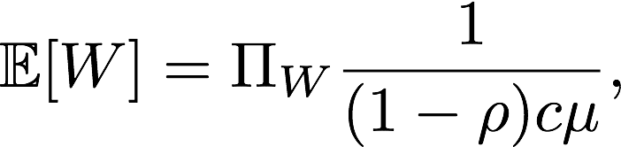
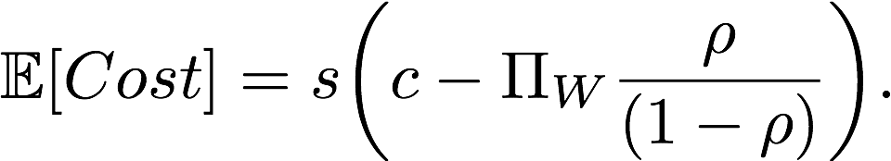
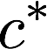
Queuing theory: the easy bits
In an M/M/c queue served by c workers, the expected wait time is
And the expected cost of the queue if workers are paid salary s is
We find the optimal queue size by minimizing a weighted average of the two.

Slide 64
Control theory: the easy bits
Process variable: parameter of interest. We use our optimal crowd size .
PID control system: u_{k} is set according to current, past, and derivative of observed error.
Control Error (e_{t})
Action u_{k}
(# new workers)
-
Controller
System
Set Point
(c*)
Feedback
(actual pool size)

Slide 65
Reminder:
a crowd is a distributed system!
^
not quite

Slide 66
Cross-pool transfers
In a multi-tenant system, we can transfer workers between applications.
Workers have preferences for different tasks, and must be trained to work on new task types.
When is it worth it to do so? (impacts performance and worker preference).

Slide 67
Cross-pool transfers: performance
Idea: simulate the transfer, then use queuing theory to predict the effect on performance.
As a proxy for performance, we use time to clear the current queue.

Slide 68
Cross-pool transfers: performance
Estimated queue completion:
3 seconds
Estimated queue completion:
0 seconds
T3
T2
T1
Worker Pool
Worker Pool

Slide 69
Cross-pool transfers: performance
Estimated queue completion:
1.5 seconds
Estimated queue completion:
0 seconds
T3
T2
T1
Worker Pool
Worker Pool

Slide 70
Cross-pool transfers: performance
Estimated queue completion:
1.5 seconds
Estimated queue completion:
0 seconds
T3
T2
T1
Worker Pool
Worker Pool
Adjust for
training time!

Slide 71
Cross-pool transfers: preferences
Idea: simulate the transfer, then compute the net preference of the system.
Assumption: workers have a preference in [0, 1] for every task type.
Then net preference is the sum of each worker’s preference for the task they are working on.

Slide 72
Putting it together
To decide on cross-pool transfers, we:

Slide 73
Putting it together
To decide on cross-pool transfers, we:
Search the space of possible transfer sets

Slide 74
Putting it together
To decide on cross-pool transfers, we:
Search the space of possible transfer sets
Simulate each transfer set and compute a performance and a preference score

Slide 75
Putting it together
To decide on cross-pool transfers, we:
Search the space of possible transfer sets
Simulate each transfer set and compute a performance and a preference score
Pick the transfer set that maximizes the weighted average of the two scores.

Slide 76
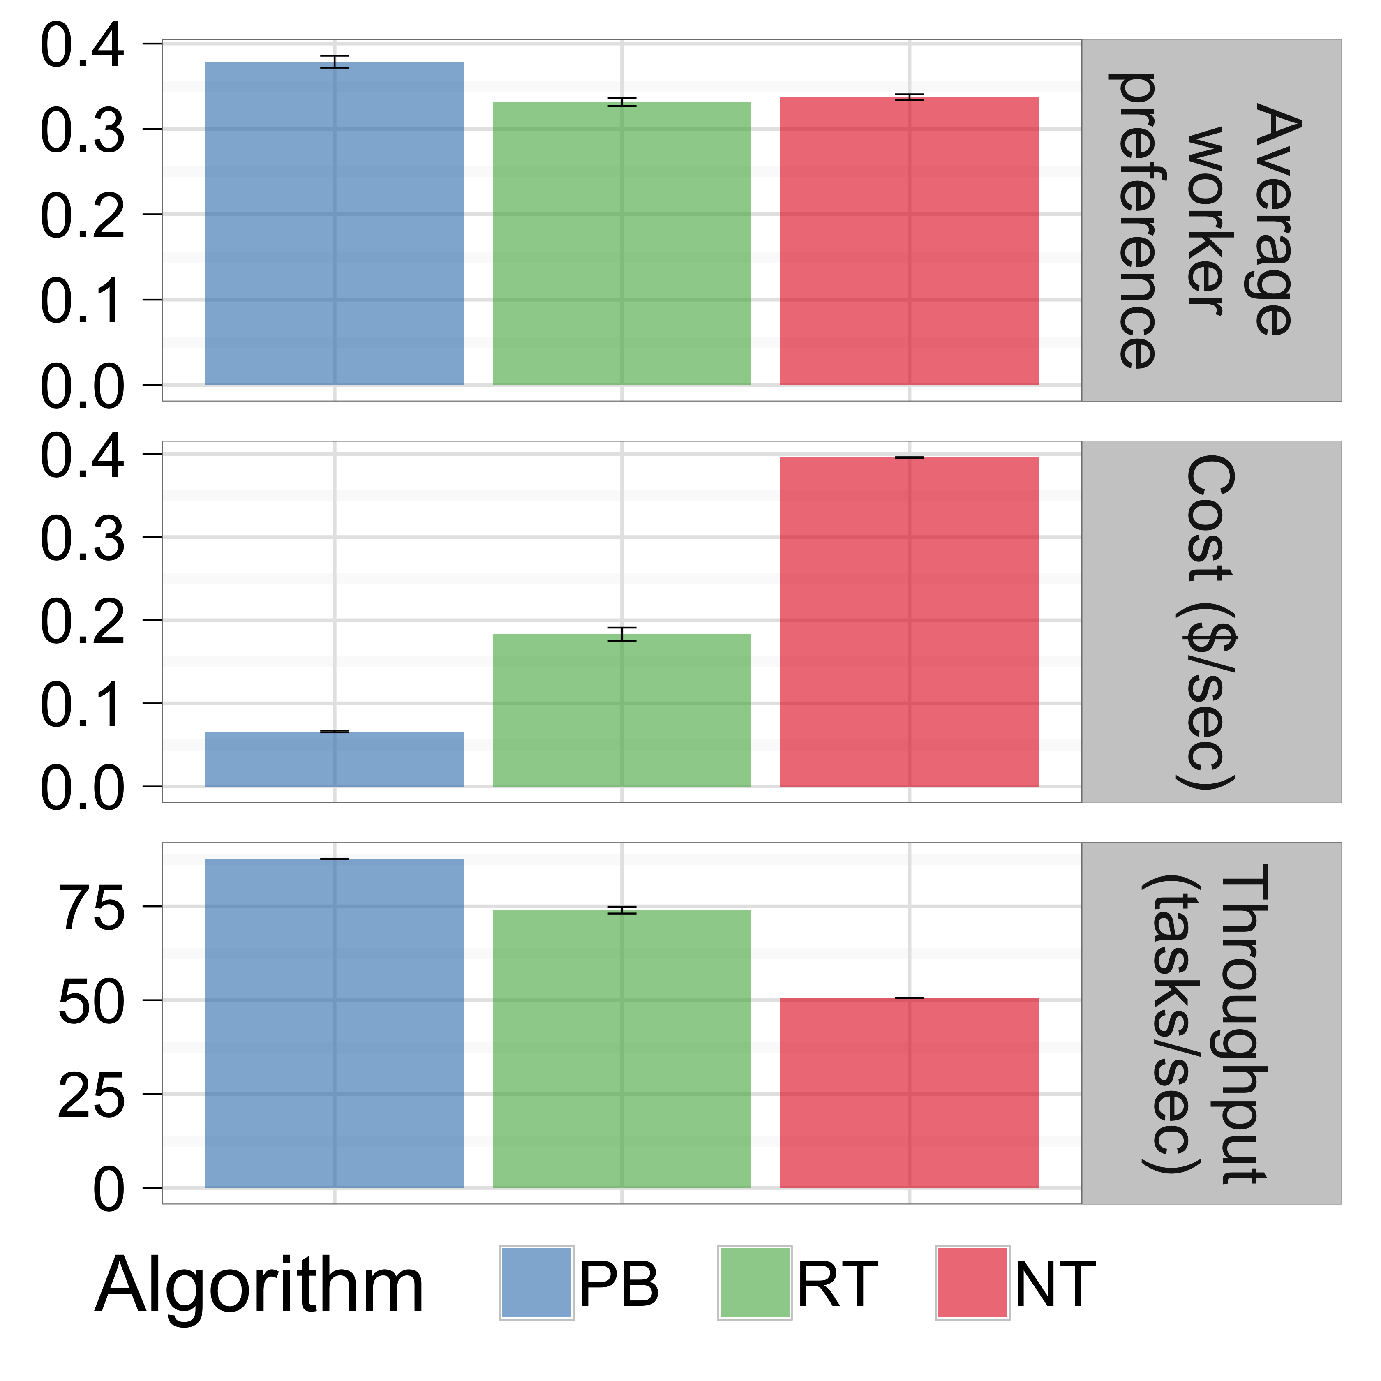
Evaluation: cross-pool transfers
Up to 76% higher throughput, 27X less cost,
43% higher net preference than
without cross-pool transfer.

Slide 77
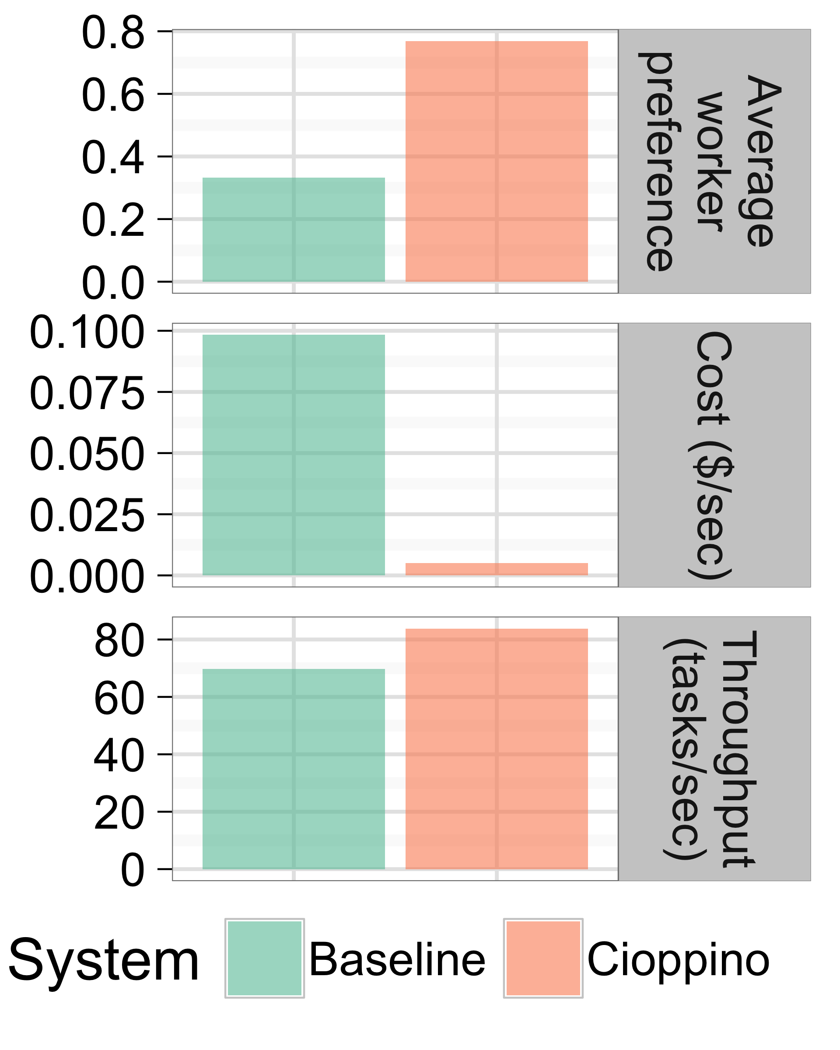
Evaluation: end-to-end
Avg. 20% higher throughput, 19X less cost,
2.3X higher net preference than
state-of-the-art systems.

Slide 78
Cioppino: summary
Client Application
Client Application
Requests
Requests
Task Queue
Task Queue
T3
T2
T1
T1
Worker Pool
Worker Transfer
Worker Pool
Worker
Recruitment
Worker Abandonment
Worker Abandonment
Crowd Platform

Slide 79
Conclusion: performant crowd systems
Data Analysts
Automated Applications
Requests
Requests
Interactive timescales
Reliable response times
For many applications
Tasks
Crowd Platform

Slide 80
Thanks!
(especially my committee: Mike Franklin, Ken Goldberg, Joe Hellerstein, and Tom Griffiths)

Slide 82
Backup Slides

Slide 83
Latency and quality control
Y
N
Techniques are complimentary, but can get expensive!
Y
N
Y
N
Y
N
Y
N

Slide 84
Motivation from Data Cleaning
1.
webpages
Count(*)
Sample
Rule: Extract address
[VLDB Demo 2015]

Slide 85

Motivation from Data Cleaning
1.
webpages
Count(*)
Sample
Rule: Extract address
2.
webpages
Rule: Extract address
[VLDB Demo 2015]

Slide 86
Motivation from Data Cleaning
1.
webpages
Count(*)
Sample
Rule: Extract address
2.
webpages
Rule: Extract address
3.
webpages
Crowd: Extract address
[VLDB Demo 2015]

Slide 87
Motivation from Data Cleaning
1.
webpages
Count(*)
Sample
Rule: Extract address
2.
webpages
Rule: Extract address
3.
webpages
Crowd: Extract address
4.
webpages
Rule: Extract address
Crowd + Active Learning:
Extract address
[VLDB Demo 2015]

Slide 88

The Most Biased Coin Problem
Magic bag with infinite coins!
Coins are ‘heavy’ (with mean )
or ‘light’ (with mean )
You get a heavy coin with probability
You get a light coin with probability
Goal: identify a heavy coin!
[Chandrasekaran et al. 2014]

Slide 89
Intuition
We should draw a heavy coin every coins
After flips, we should be able to tell a heavy coin from a light coin
If we don’t know , it should take longer!

Slide 90
Existing algorithms
Best expected sample complexity bounded at
if the parameters are known!

Slide 91
Existing algorithms
Best expected sample complexity bounded at
if the parameters are known!
Matches Intuition

Slide 92
Can we keep things simple?
Fixed sample-size algorithm:
for i = 1 ... n:
draw coin i from the bag
flip coin i m times
if cond(): declare coin i heavy
return null

Slide 93
Does an algorithm like this work?
If parameters are known,

Slide 94
Does an algorithm like this work?
If parameters are known,
If parameters are unknown, however,
for any fixed sample-size algorithm that underestimates m.

Slide 95
Does an algorithm like this work?
If parameters are known,
If parameters are unknown, however,
for any fixed sample-size algorithm that underestimates m.
Quadratically Worse!

Slide 96
Our adaptive algorithm
for i = 1 … n:
for j = 1 … m:
:= flip coin i for the jth time.

Slide 97
Our adaptive algorithm
for i = 1 … n:
for j = 1 … m:
:= flip coin i for the jth time.
if :
declare coin i heavy

Slide 98
Our adaptive algorithm
for i = 1 … n:
for j = 1 … m:
:= flip coin i for the jth time.
if :
declare coin i heavy

Slide 99
Our adaptive algorithm
for i = 1 … n:
for j = 1 … m:
:= flip coin i for the jth time.
if :
declare coin i heavy
else if :
break
output null

Slide 100
Our adaptive algorithm
Stop early if we’re confident!
for i = 1 … n:
for j = 1 … m:
:= flip coin i for the jth time.
if :
declare coin i heavy
else if :
break
output null
Stop early if we’re confident!

Slide 101
Handling unknown parameters
Guess (too high) values for
Run our algorithm—it will output null!
Decrease our guesses and repeat
We show that with high probability, our algorithm works with underestimates, but not with overestimates

Slide 102
Complexity
If parameters are unknown,

Slide 103
Complexity
If parameters are unknown,
Matches intuition!

Slide 104
Complexity
Within log-factors of known parameter case
If parameters are unknown,
Matches intuition!

